Slide 1
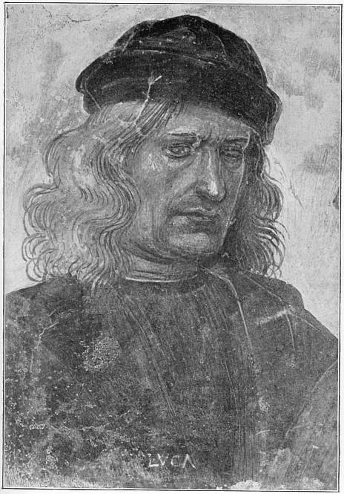

Luca Signorelli
(1445-1523)
Italian Renaissance Painter
PORTRAIT OF SIGNORELLI

Slide 2
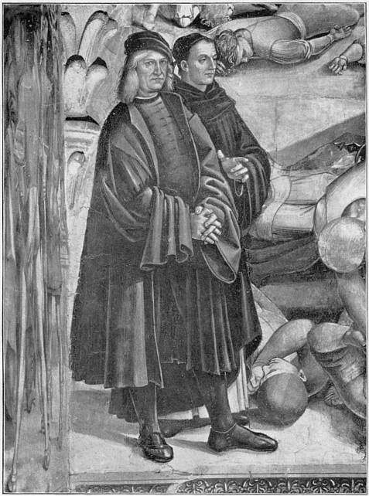
Self portrait of Luca Signorelli (left) with Fra Angelico

Slide 3
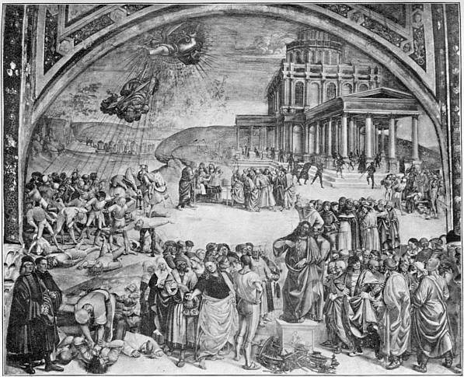
THE PREACHING AND FALL OF ANTICHRIST

Slide 4
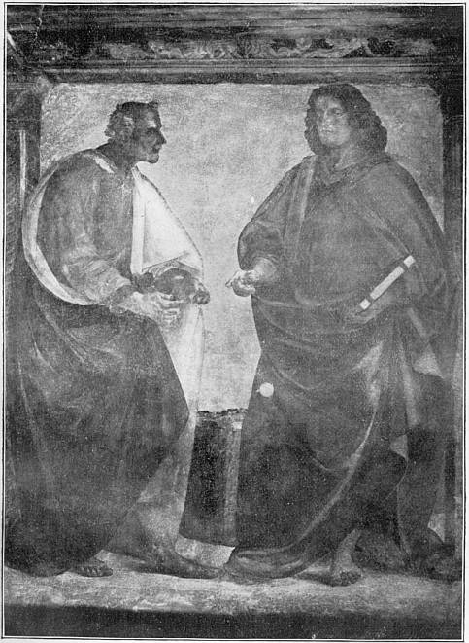
APOSTLES

Slide 5
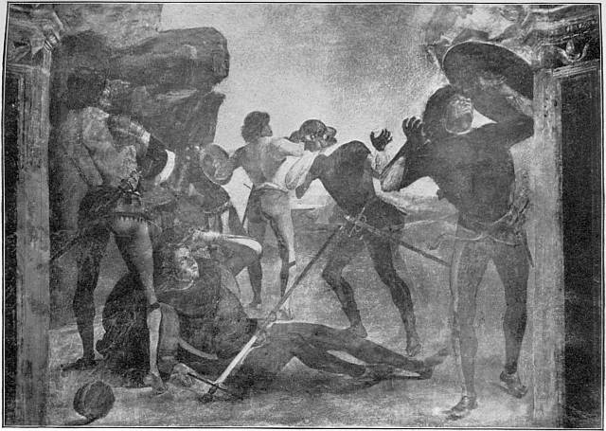
THE CONVERSION OF SAUL

Slide 6
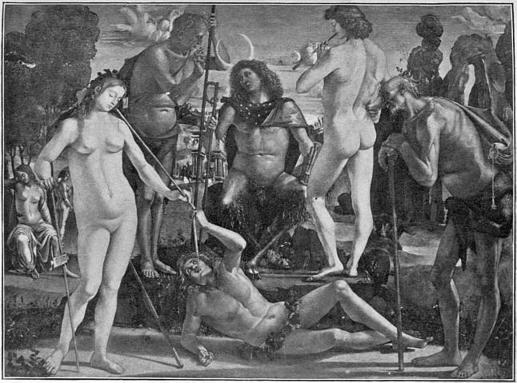
PAN

Slide 7
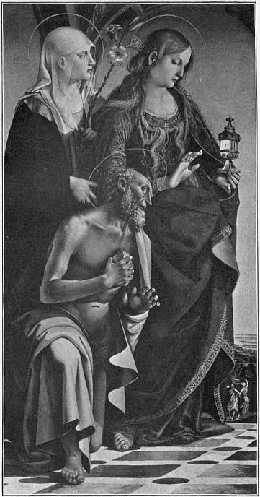
SAINTS

Slide 8
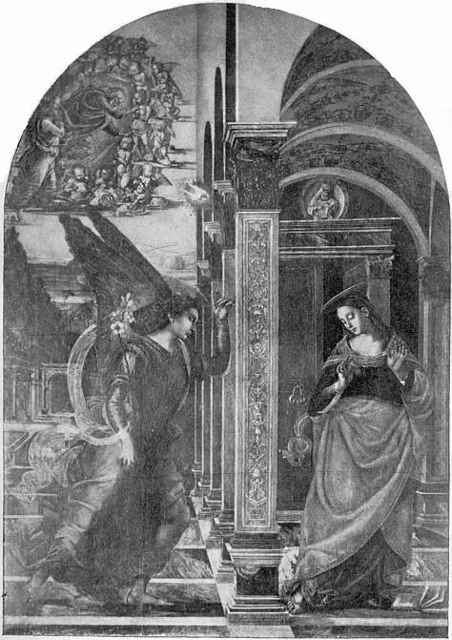
THE ANNUNCIATION

Slide 9
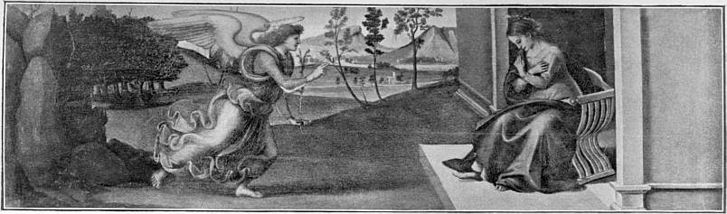
THE ANNUNCIATION

Slide 10
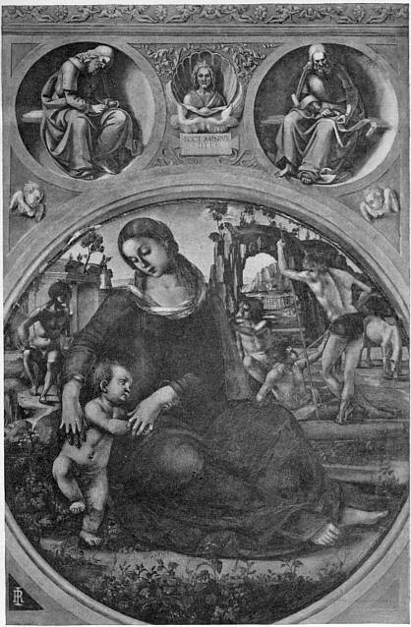
MADONNA

Slide 11
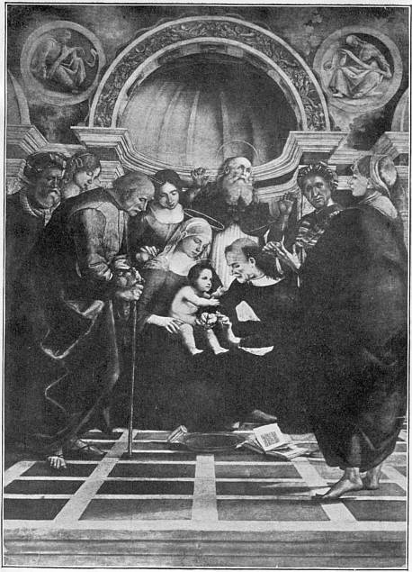
MADONNA AND SAINTS

Slide 12
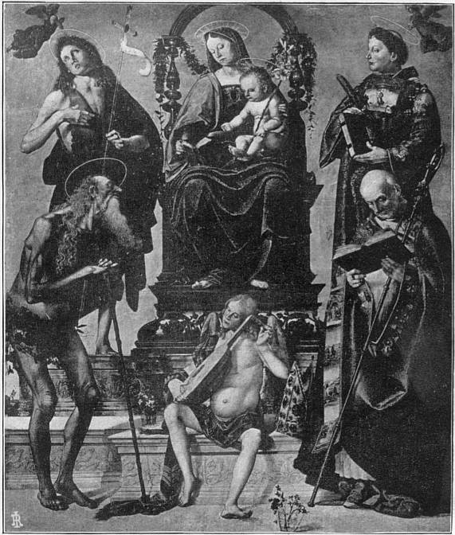
MADONNA AND SAINTS

Slide 13
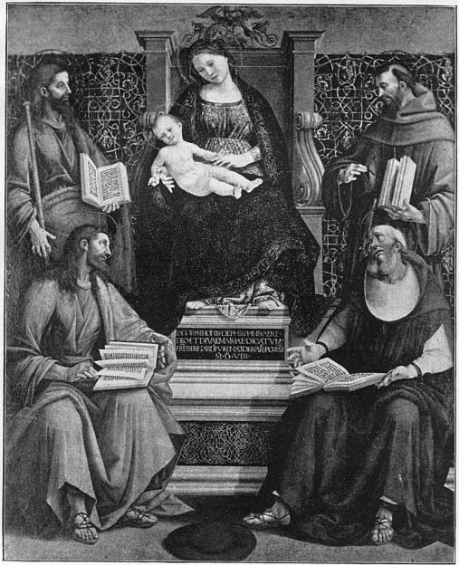
MADONNA AND SAINTS

Slide 14
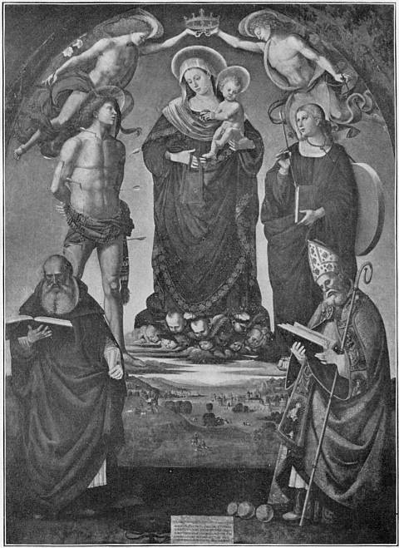
MADONNA AND SAINTS

Slide 15
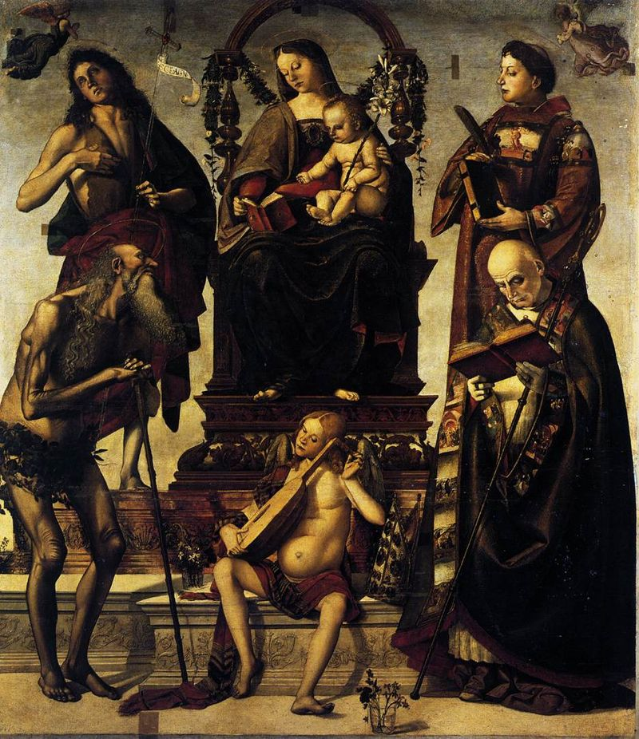
Madonna and Child
with Saints

Slide 16
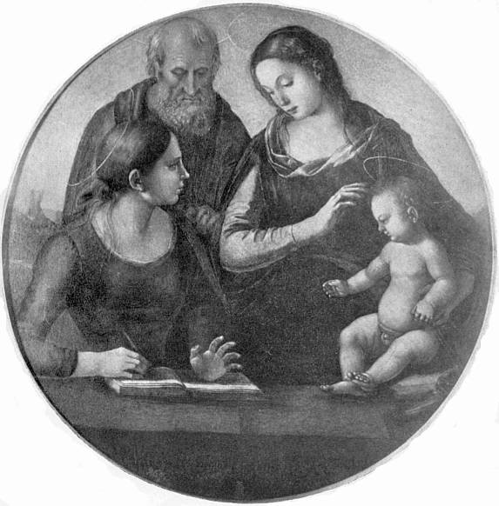
MADONNA AND SAINTS

Slide 17
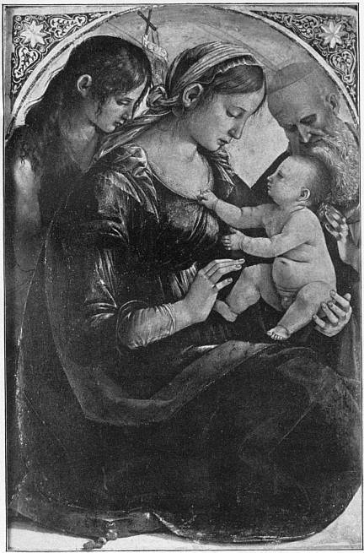
HOLY FAMILY

Slide 18
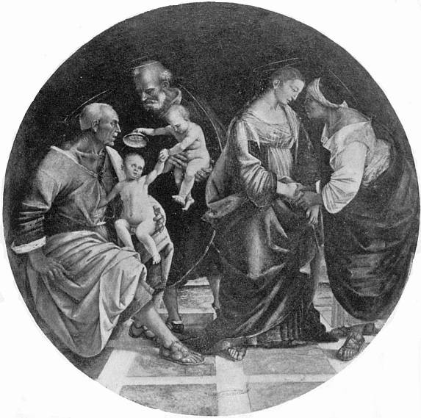
HOLY FAMILY

Slide 19
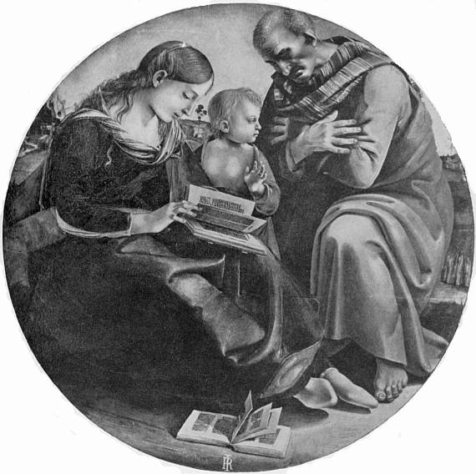
HOLY FAMILY

Slide 20
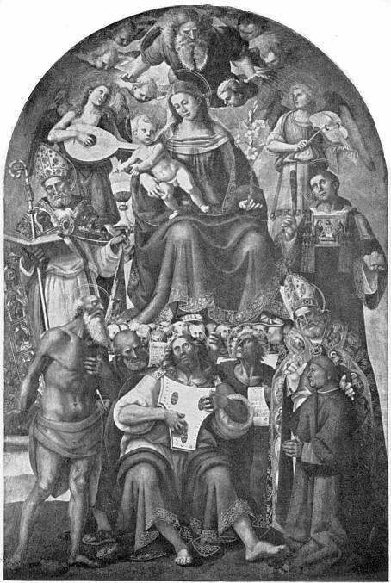
MADONNA, SAINTS, AND PROPHETS

Slide 21
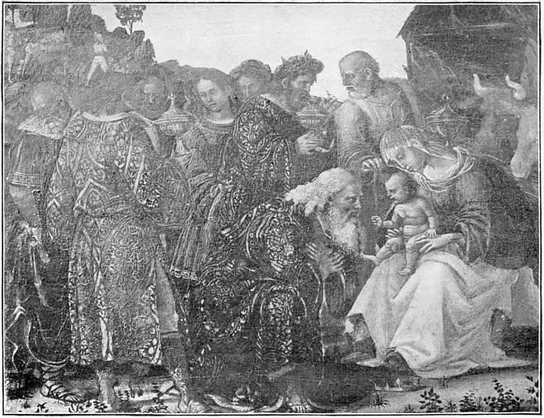
THE ADORATION OF THE MAGI

Slide 22
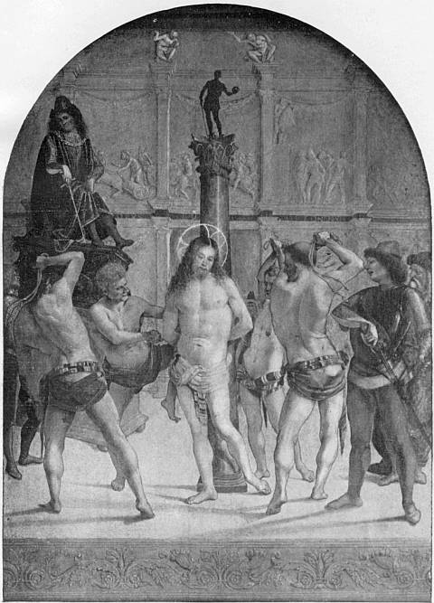
THE FLAGELLATION

Slide 23
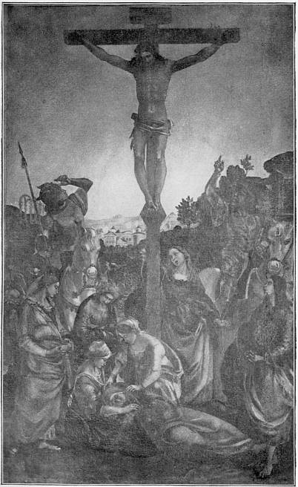
THE CRUCIFIXION

Slide 24
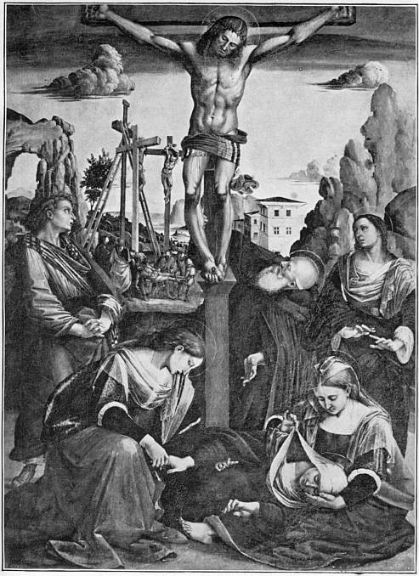
THE CRUCIFIXION

Slide 25
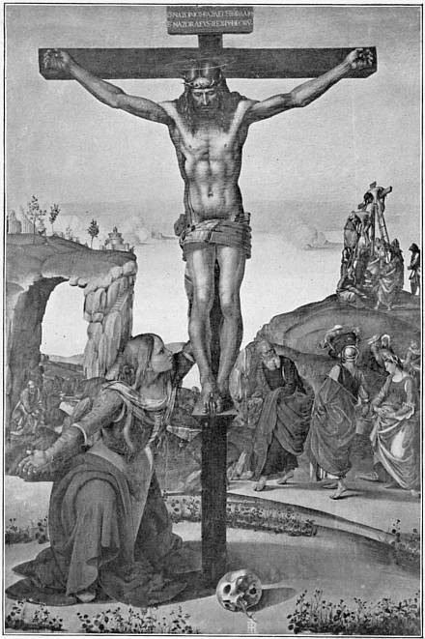
MAGDALEN
AT THE FOOT OF THE CROSS

Slide 26
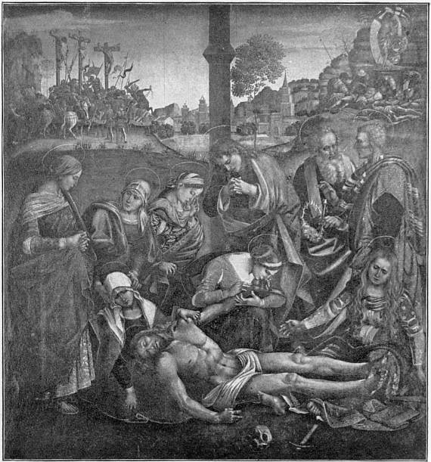
THE DEPOSITION

Slide 27
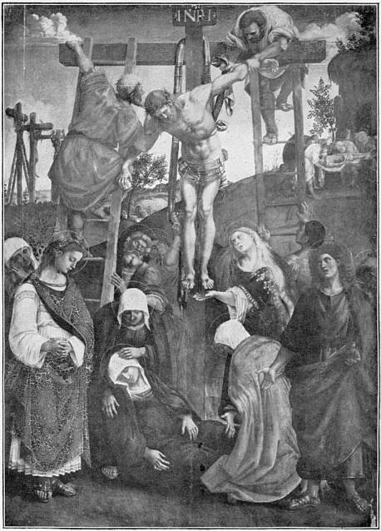
THE DEPOSITION

Slide 28
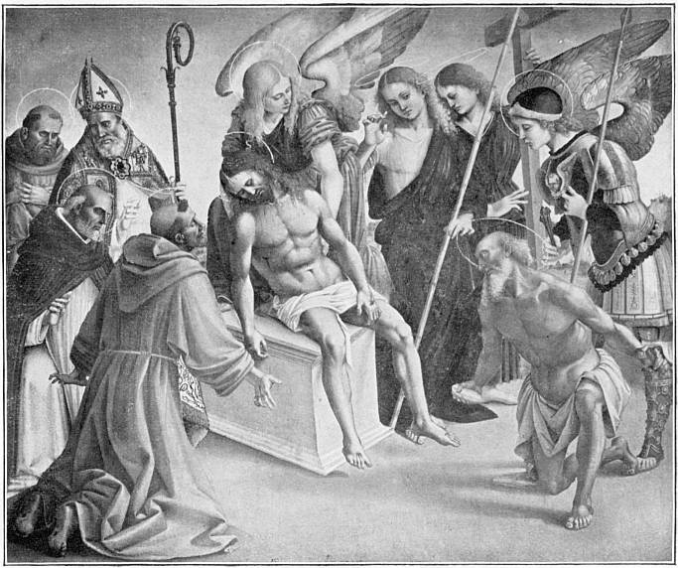
DEAD CHRIST UPHELD BY ANGELS

Slide 29
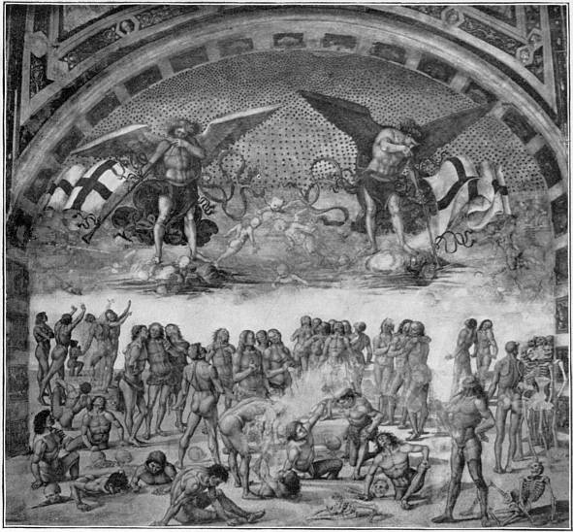
THE RESURRECTION

Slide 30
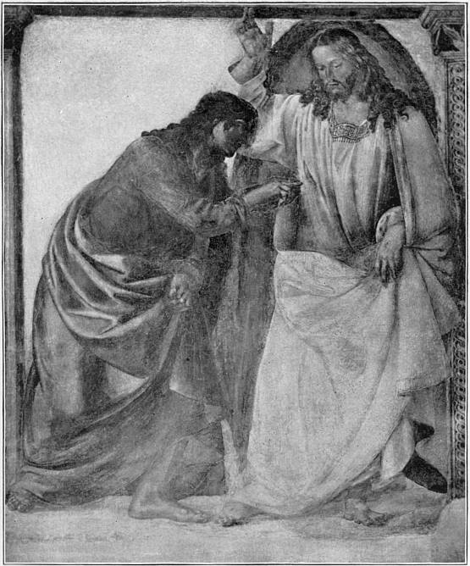
THE INCREDULITY
OF
S. THOMAS
Notes:
END

Slide 31
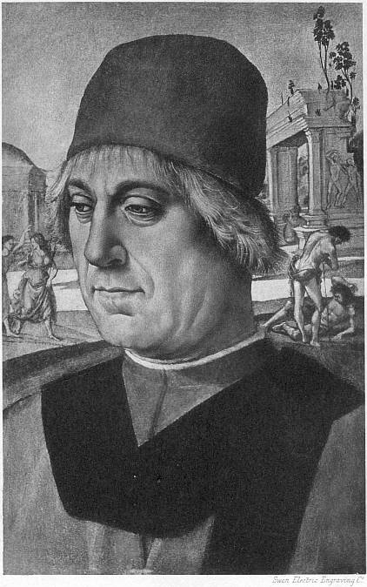
Portrait of Man
END
Notes:
Portrait of Man

