Slide 1
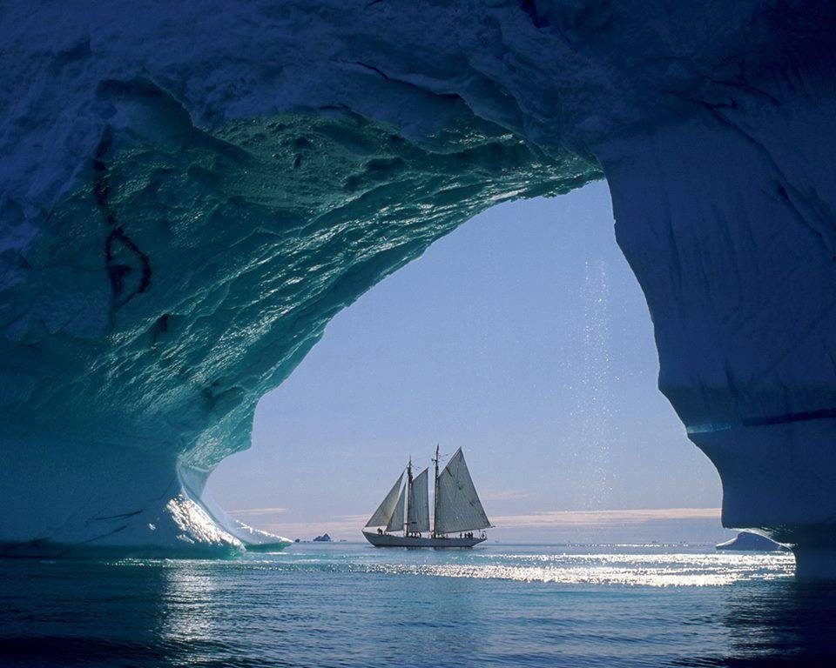

Greenland, Denmark
Notes:
Greenland, Denmark

Slide 2
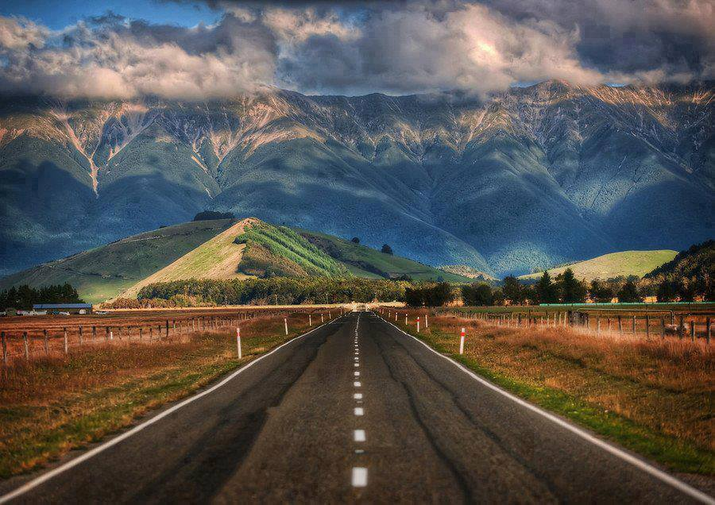
Beautiful New Zealand
Notes:
Beautiful New Zealand

Slide 3
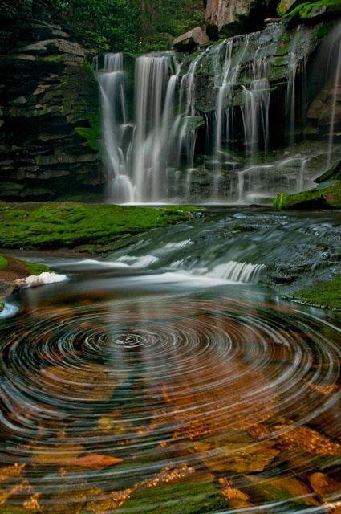
Blackwater Falls State Park,
West Virginia
Notes:
The water spirals of Elakala Waterfalls ~ Blackwater Falls State Park, West Virginia

Slide 4
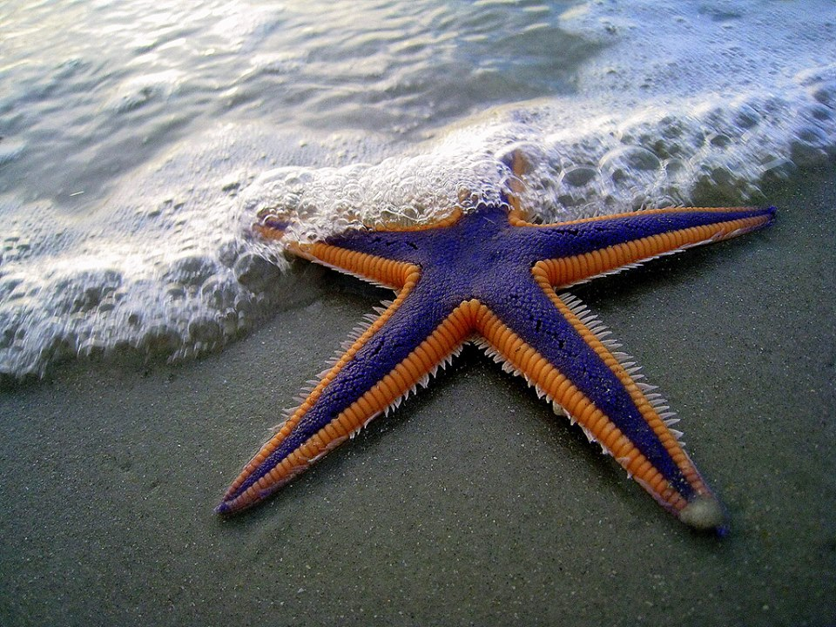
Purple and Orange Starfish
Notes:
Purple and Orange Starfish on the Beach

Slide 5
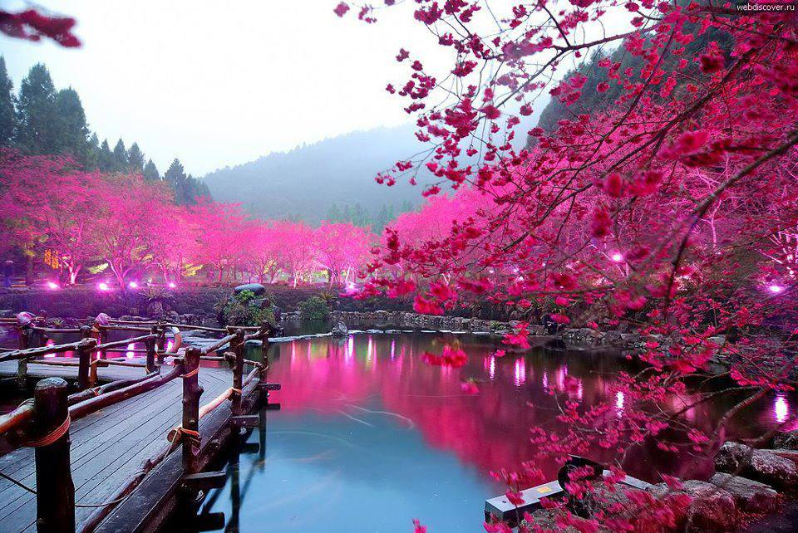
Cherry Blossom Lake (Sakura, Japan)
Notes:
Awesome Lighted Cherry Blossom Lake (Sakura, Japan) - Beautiful

Slide 6
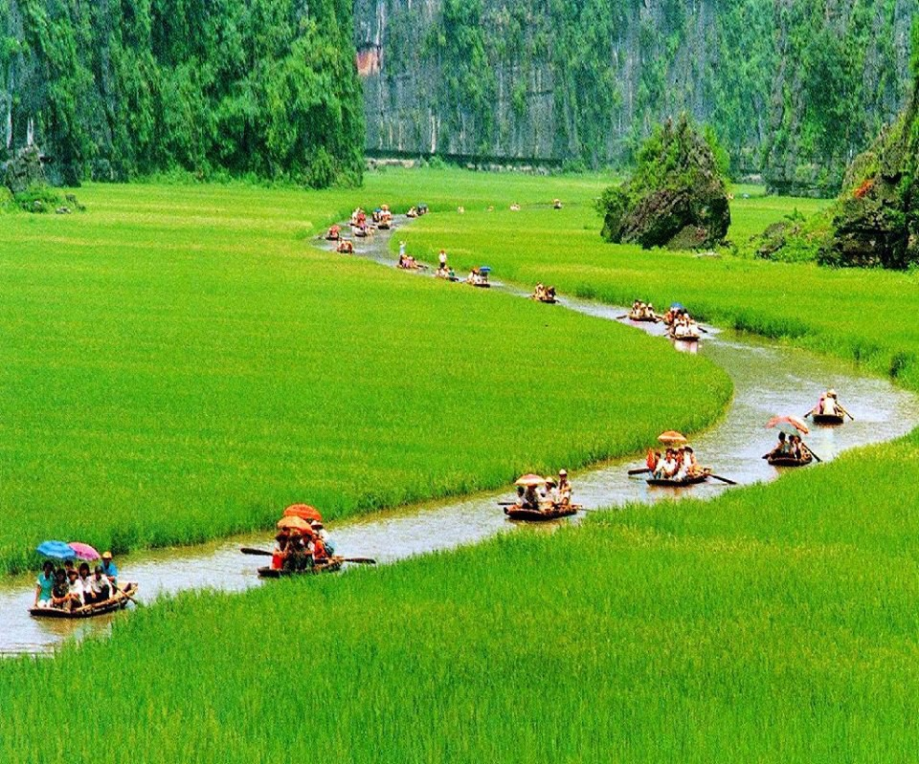
Canal River , Vietnam
Notes:
Scintillating unique place Somewhere in Vietnam .. Canal River through a paddyfield

Slide 7
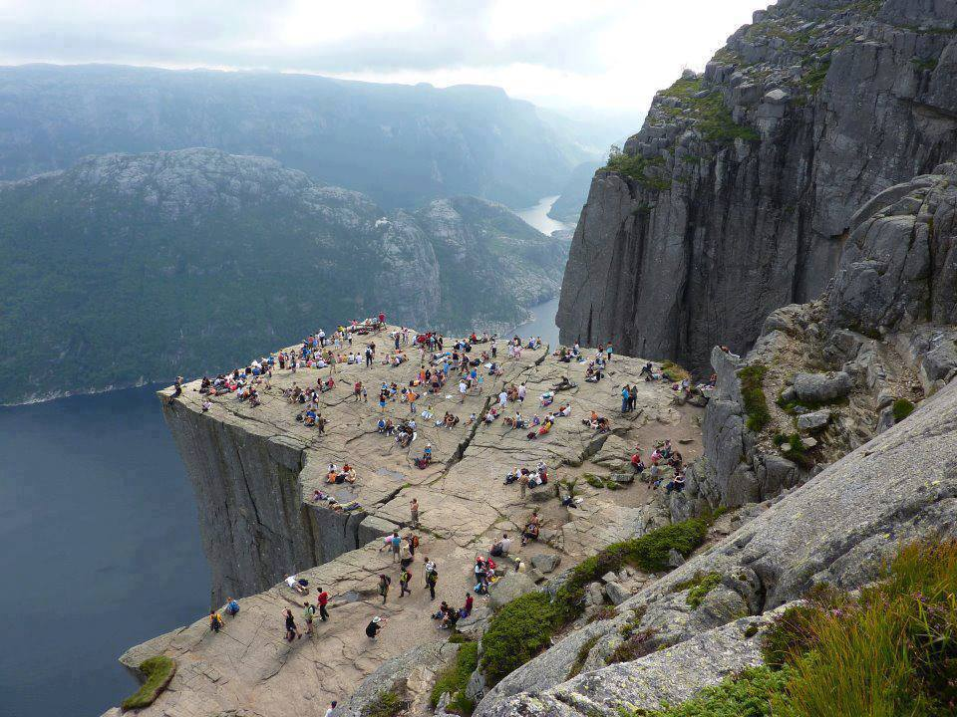
Preikestolen, Norway
Notes:
Preikestolen, Norway

Slide 8
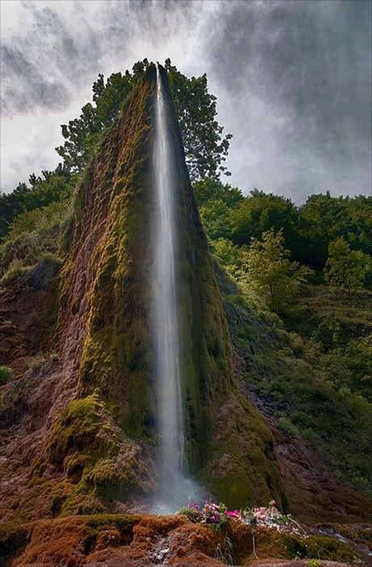
Prskalo Waterfall, Serbia
Notes:
Prskalo Waterfall, Serbia

Slide 9
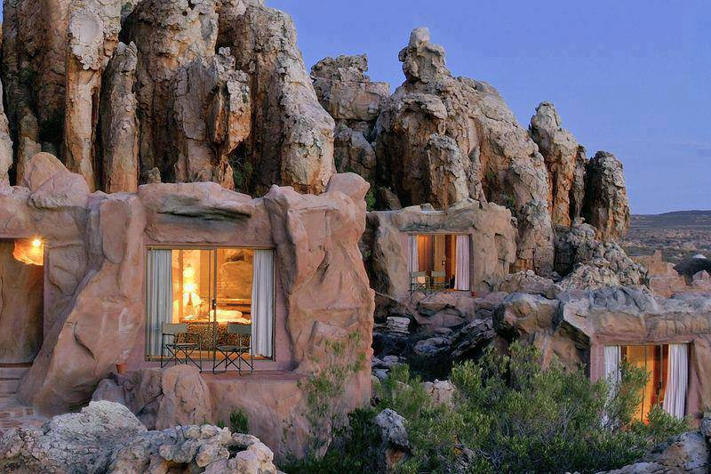
Cave Hotel in Cederberg Mountains, South Africa
Notes:
Cave Hotel in Cederberg Mountains, South Africa

Slide 10
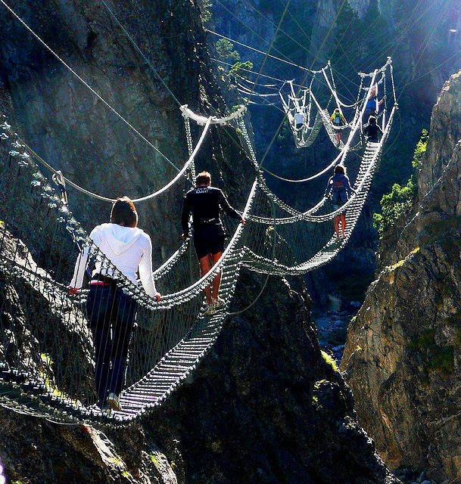
The Tibetan Bridge in Claviere, Piedmont, Italy
Notes:
The Tibetan Bridge in Claviere, Piedmont, Italy

Slide 11
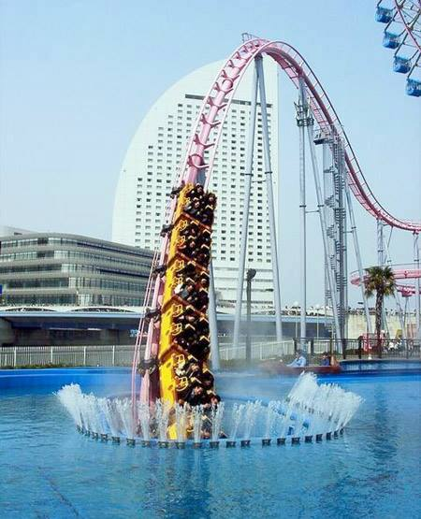
Roller Coaster in Japan
Notes:
Vanishing Underwater Roller Coaster in Japan

Slide 12
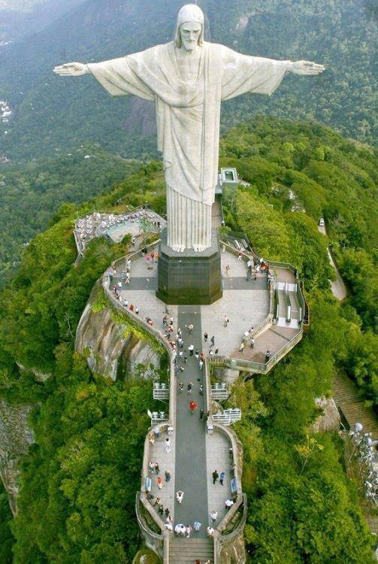
Christ the Redeemer Statue, Rio
Notes:
Christ the Redeemer Statue overlooking the whole of Rio

Slide 13
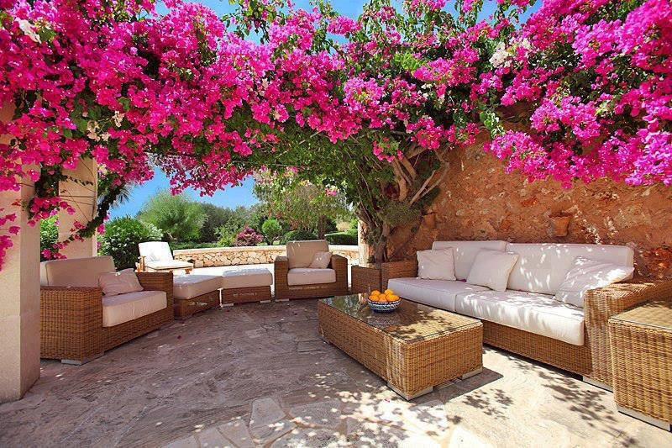
A Bougainvilla Patio Garden
Notes:
A Bougainvilla Patio Garden

Slide 14
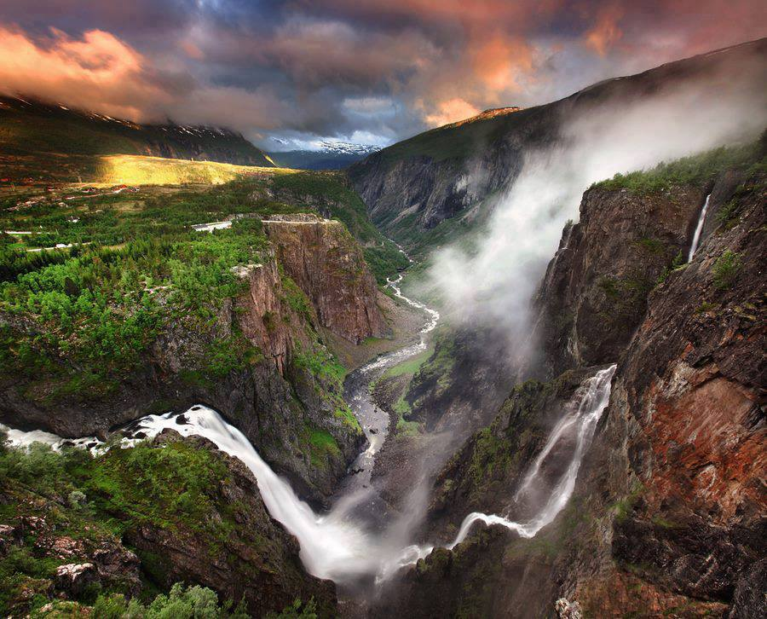
Voringfossen waterfall, Norway
Notes:
Voringfossen is the 83rd highest waterfall in Norway on the basis of total fall

Slide 15
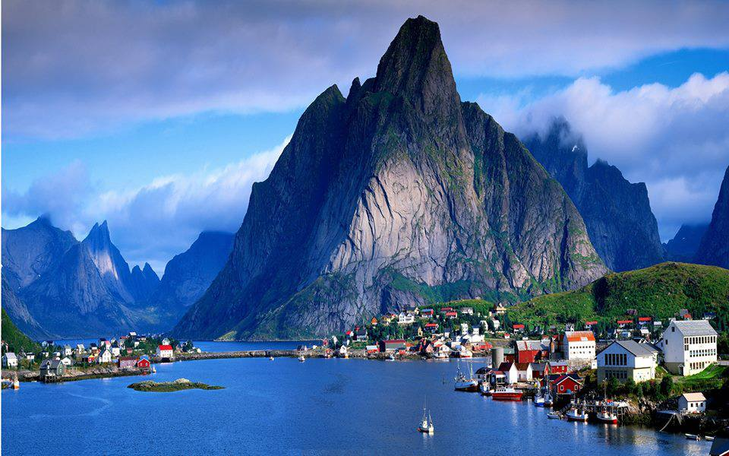
Gudvangen, Norway
Notes:
Gudvangen, Norway

Slide 16
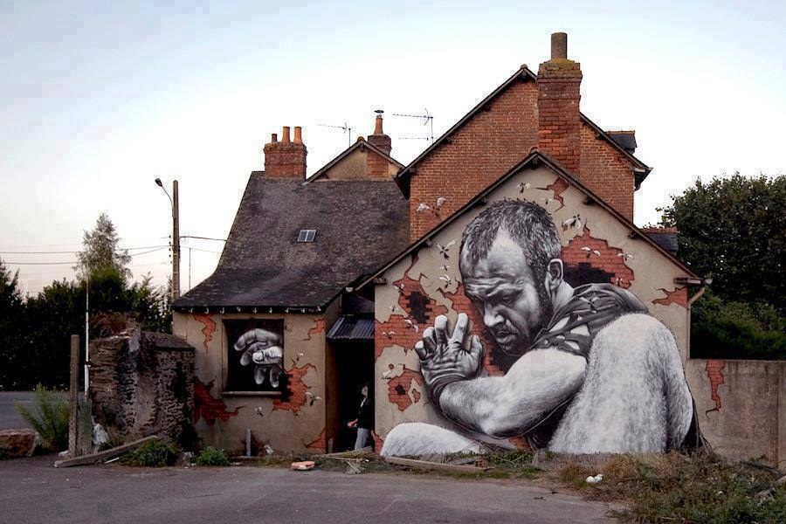
Rennes, France
Notes:
3 D Street Art, Rennes, France

Slide 17
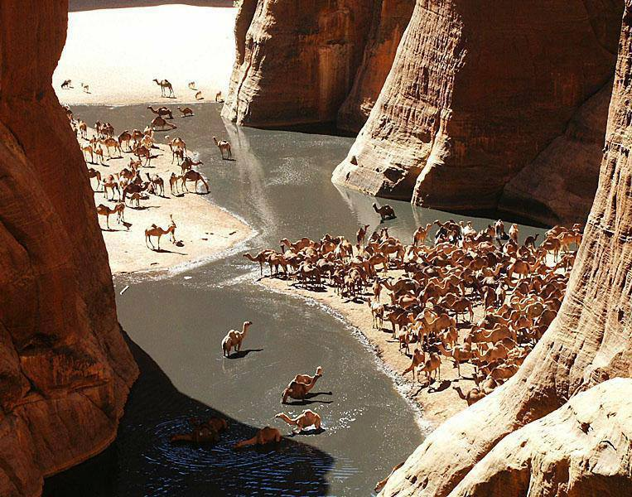
Guelta d'Archei Oasis, Sahara Desert
Notes:
Guelta d'Archei Oasis, Sahara Desert

Slide 18
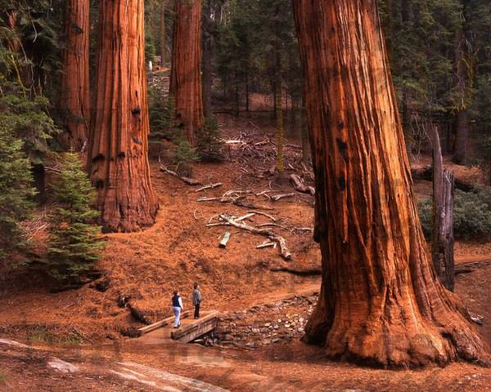
The Redwoods, California
Notes:
Perspective, The Redwoods, California (The Redwood Forest)

Slide 19
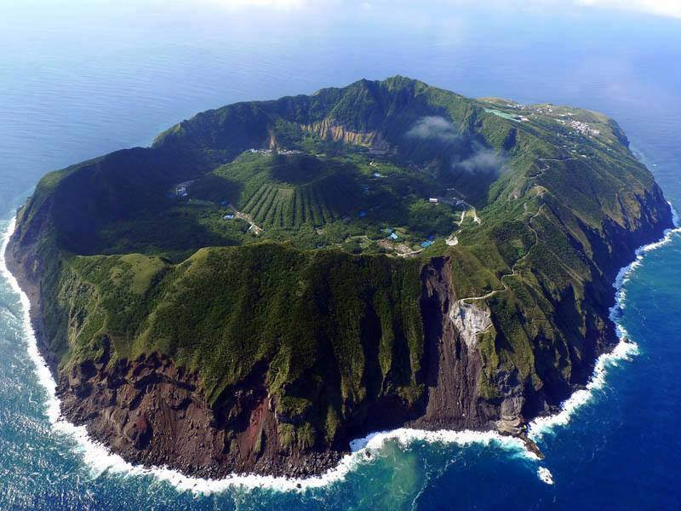
Volcanic Island of Aogashima, Japan
Notes:
The Inhabited Volcanic Island of Aogashima, Japan

Slide 20
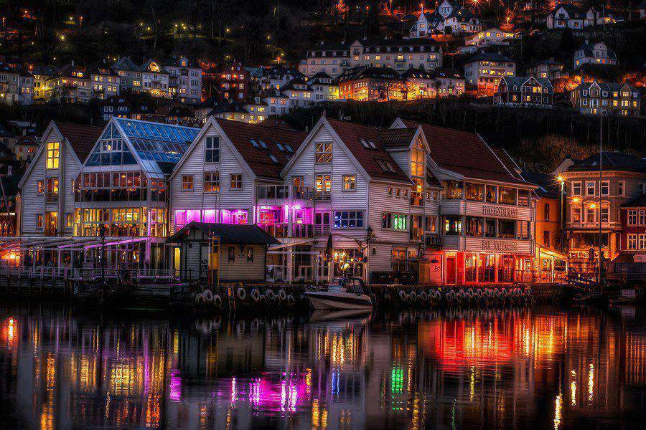
Bergen, Norway
Notes:
Zachariasbryggen - Bergen, Norway

Slide 21
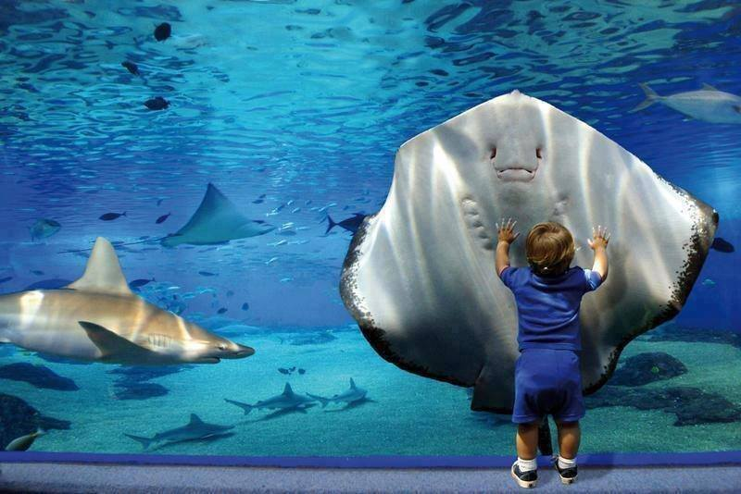
Giant Aquarium
Notes:
Facing a Manta Ray through a Giant Aquarium.

Slide 22
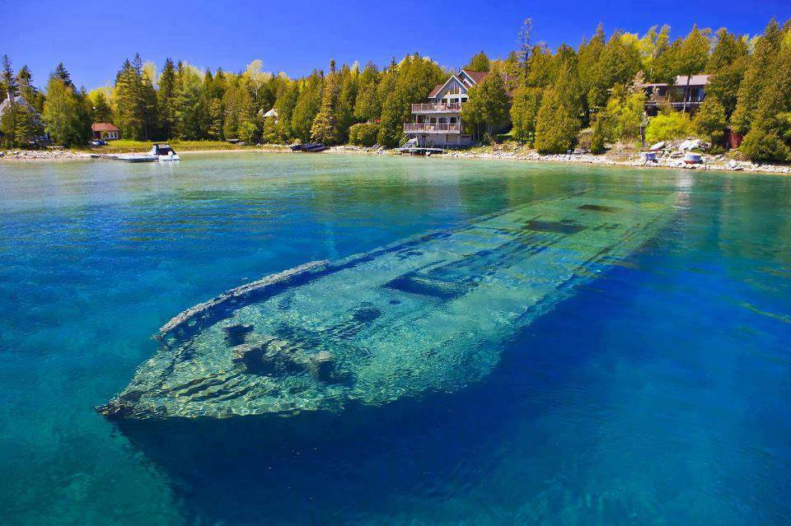
Blue water of Lake Huron,Ontario
Notes:
Under the clear blue water of Lake Huron in Ontario

Slide 23
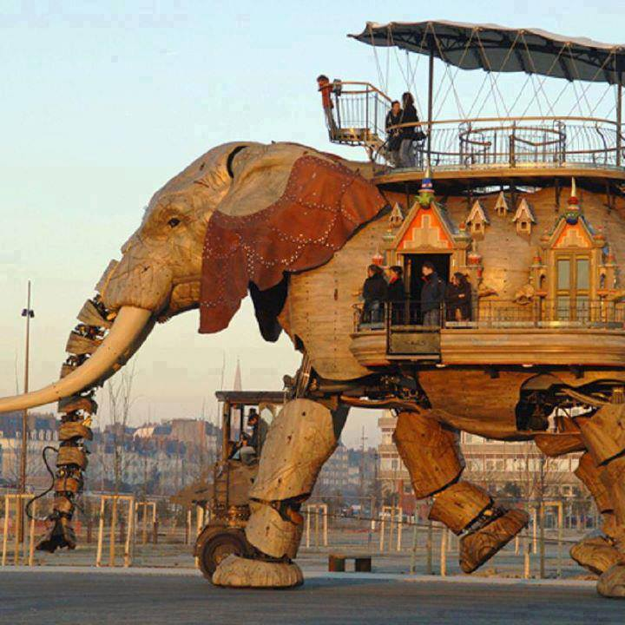
Artificial Elephant, Nantes, France
Notes:
The Great Artificial Elephant, Nantes, France

Slide 24
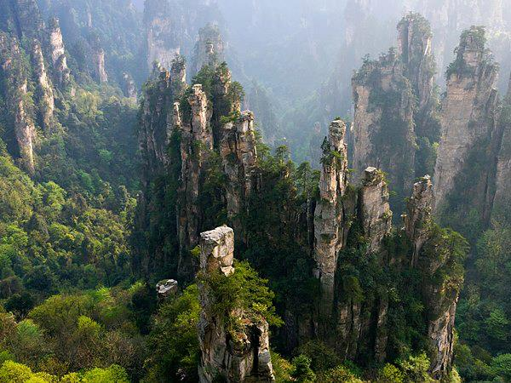
Stone Forest in Hunan, China
Notes:
Zhangjiaje Stone Forest in Hunan, China. It is the inspiration for the floating mountains in the movie "Avatar."

Slide 25
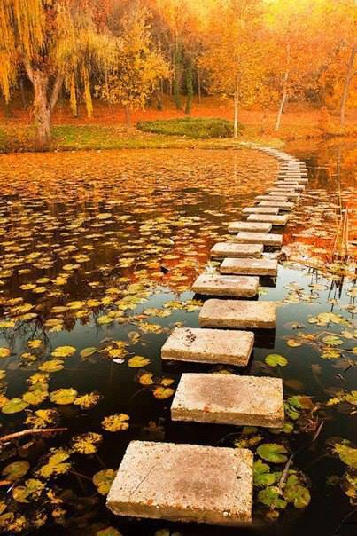
A stone path across a lake in Poland
Notes:
A stone path across a lake in Poland.

Slide 26
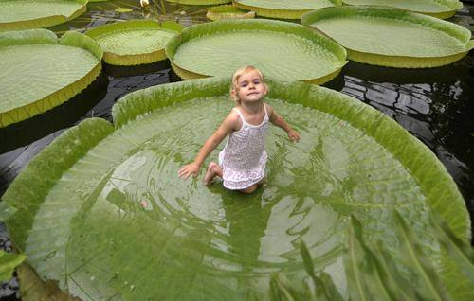
The Victoria water lily, Amazon river
Notes:
The Victoria water lily is native to the Amazon river

Slide 27
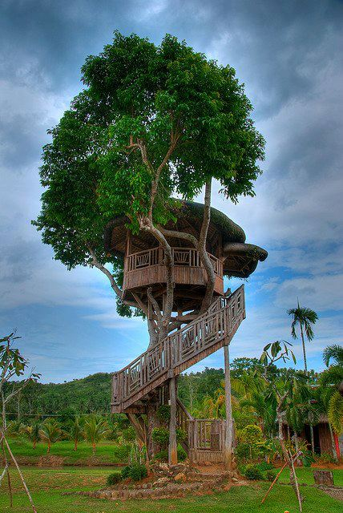
Tree house, Philippines
Notes:
Tree house, Philippines

Slide 28
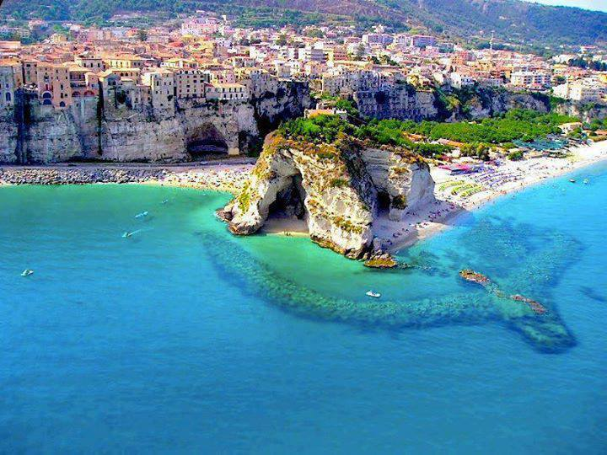
Amalfi Coast, Florence, Italy
Notes:
Off the Amalfi Coast, Florence in Italy

Slide 29
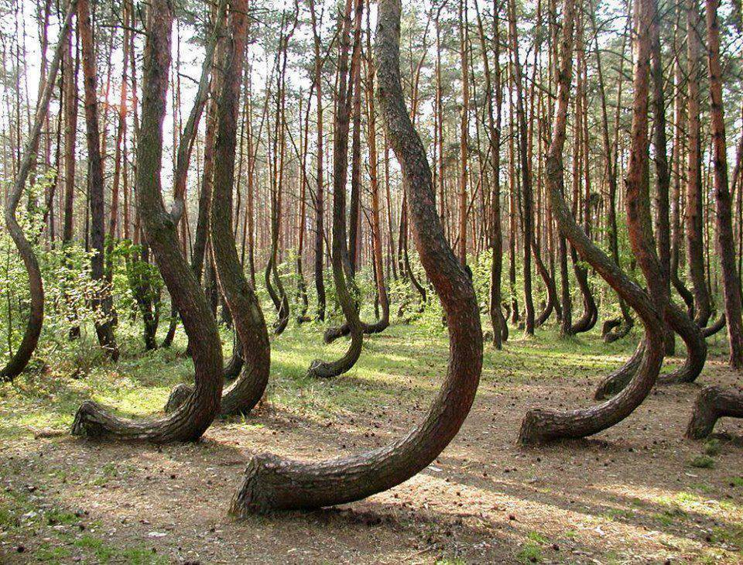
Crooked pine trees, Poland
Notes:
Poland has a forest full of bent pine trees (Crooked Forest).

Slide 30
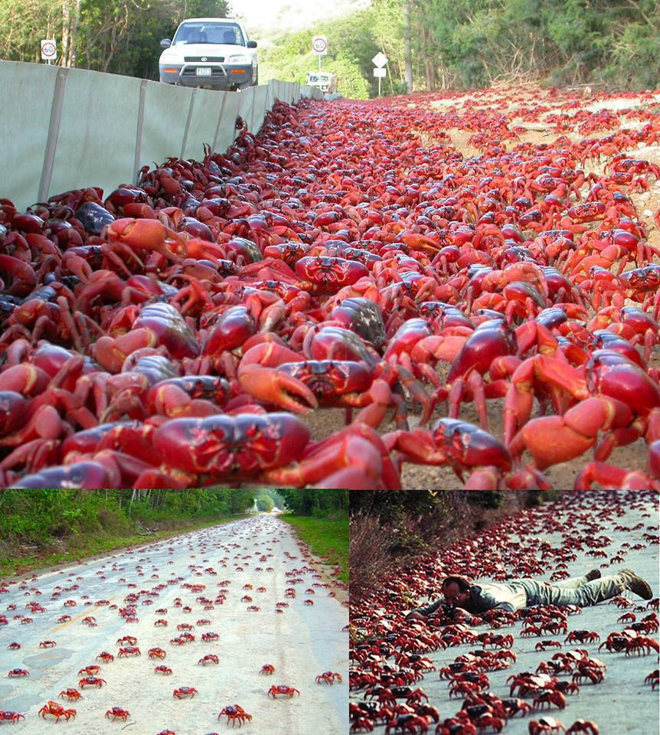
Millions of bright red crabs, Australia
Notes:
The Astonishing Annual Red Crab Migration.
Each year millions of bright red land crabs leave their burrow homes on Australia 's Christmas Island

Slide 31
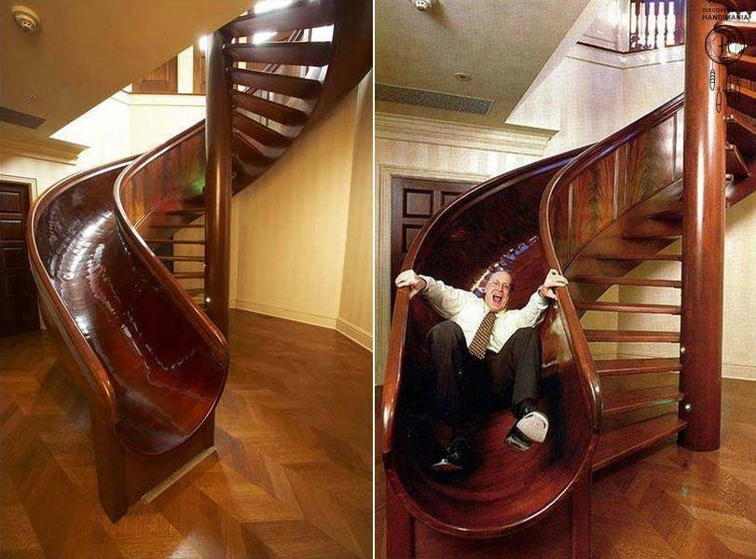
The staircase slider
Notes:
Every home should have this! - The staircase slider
Tree house, Philippines.
A stone path across a lake in Poland.
Ausangate mountain, Andes, Peru . Want to go on a trek?
The water spirals of Elakala Waterfalls ~ Blackwater Falls State Park, West Virginia.
Zhangjiaje Stone Forest in Hunan, China. It is the inspiration for the floating mountains in the movie "Avatar."
Hong Kong.
Purple and Orange Starfish on the Beach.
Greenland.
Poland has a forest full of bent pine trees (Crooked Forest).
Christ the Redeemer Statue overlooking the whole of Rio was pretty special. You could see it from everywhere you went. I also have to say that the majority of the people who lived there, including the 'natives' (especially in the favelas) knew exactly who it was and respected it and what it stands for.
Every home should have this! - The staircase slider

Slide 32
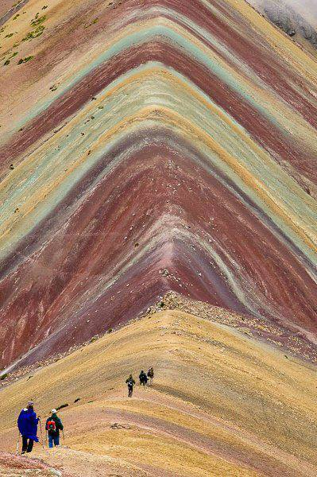
Ausangate mountain, Andes, Peru
Notes:
Ausangate mountain, Andes, Peru . Want to go on a trek?

Slide 33
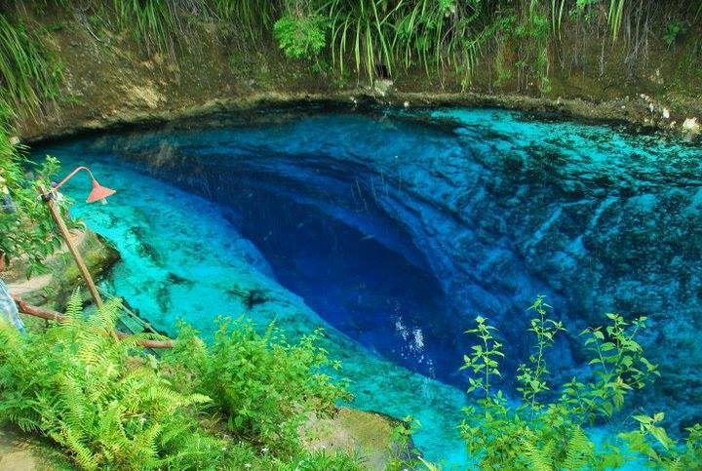
Enchanted River, Philippines
Notes:
Enchanted River is found in Philippines

Slide 34
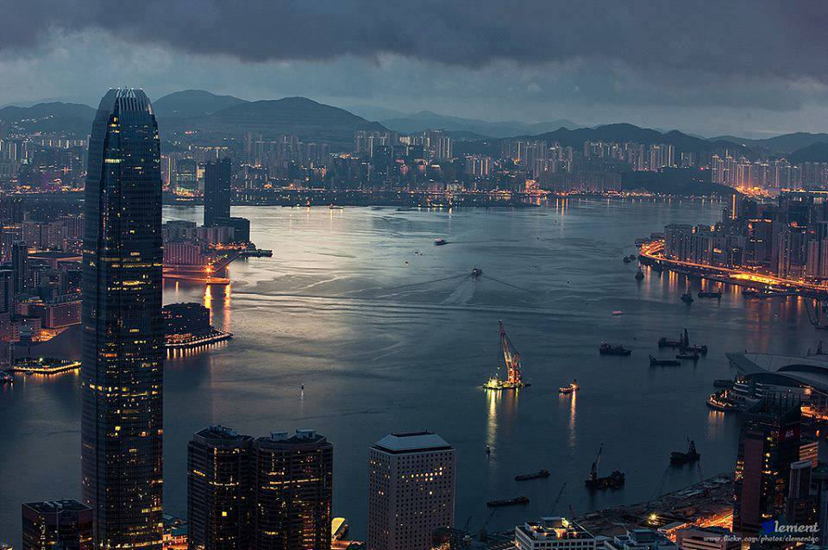
Hong Kong
Notes:
Hong Kong

Slide 35
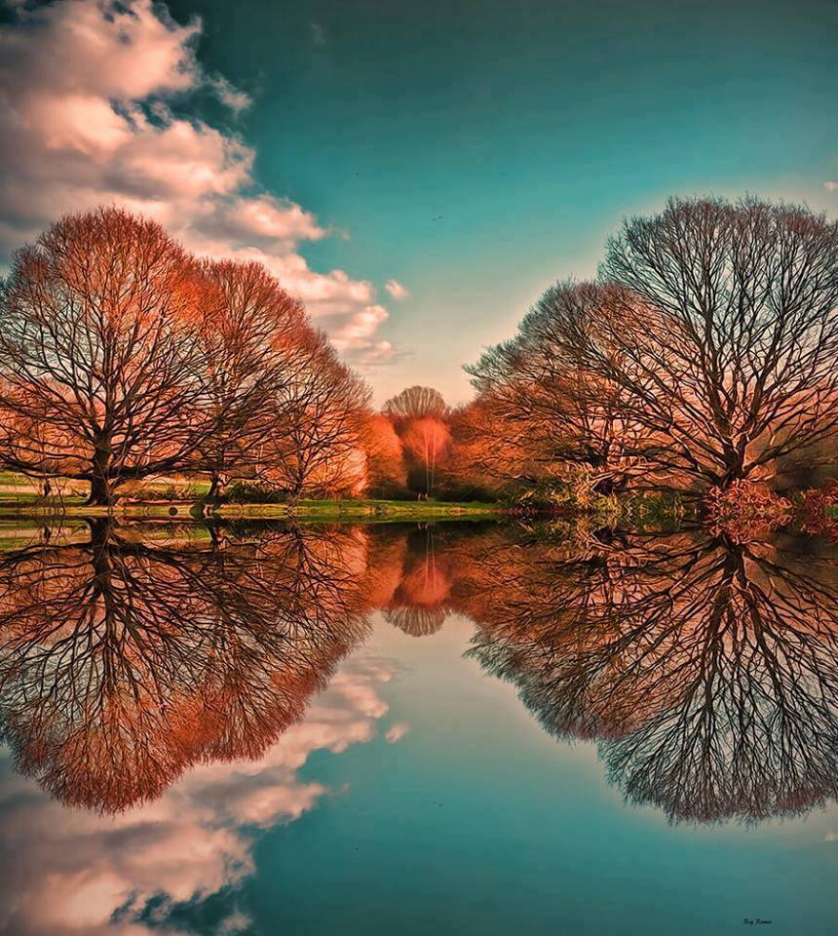
Gorgeous reflection
Notes:
Gorgeous reflection

